Slide 1
Prayer
What’s the Use?
Notes:
This title has a double meaning...what’s the use of prayer meaning does it actually “work” and what’s the use in terms of how we pray and why we pray both individually and corporately.

Slide 2
What does “prayer” or “to pray” mean?
Proseuche
The word translated as ‘prayer’ and ‘pray’
- compound Greek word derived from the words pros and euche.
pros - preposition meaning face-to-face. “In the beginning was the Word, and the Word was with God…” (John 1:1). The word “with” is taken from the word pros. The idea conveyed by this word is one of intimacy. The Holy Spirit is telling us that the Father and the Son had an intimate, face-to-face relationship in eternity past.
Notes:
1. The Greek word most often used for “prayer” in the New Testament contains much deeper meaning than most believers realize. The word demands surrender and consecration on the part of the one making the request.

Slide 3
Proseuche cont...
The second word, euche, is a Greek word that means a wish, desire, or vow. It was originally used to depict a person who made a vow to God because of some need or desire in their life. This individual would vow to give something to God of great value in exchange for a favorable answer to prayer.

Slide 4
Proseuche cont...
Put together, this word tells us two important things about prayer:
prayer should bring us face-to-face with God in an intimate relationship. Prayer is the vehicle to bring us into a close, intimate relationship with God.
the idea of sacrifice is also associated with prayer. It depicts an altar of sacrifice and consecration in prayer where our lives are yielded entirely to God. It is a place of decision and surrender where we freely vow to give our lives in exchange to God for His divine life imparted to us.
Notes:
The term sacrifice derives from the Latin sacrificium, which is a combination of the words sacer, meaning something set apart from the secular or profane for the use of supernatural powers, and facere, meaning “to make.” The term has acquired a popular and frequently secular use to describe some sort of renunciation or giving up of something valuable in order that something more valuable might be obtained; e.g., parents make sacrifices for their children, one sacrifices a limb for one’s country. But the original use of the term was peculiarly religious, referring to a cultic act in which objects were set apart or consecrated and offered to a god or some other supernatural power; thus, sacrifice should be understood within a religious, cultic context. Because the word proseuche has to do with this type of surrender, sacrifice, and consecration, it is apparent that God wants to do more than merely bless us. He wants to transform us! He wants us to place our lives in His hands as we come before His throne.

Slide 5
deesis
Translated as “supplication” or “petition”
derived from the verb deomai and most literally describes a need or a want. This word denotes a cry for God’s help that exposes our inability to meet our own needs.
James 5:17... “Elijah was a man with a nature like ours, and he prayed earnestly (Greek word deesis)…”
Elijah recognized his inability to change the situation apart from God’s intervention. He prayed earnestly (deesis), out of his deep sense of need, asking for God to intervene on his behalf.
Notes:
Our appeal to God is to be out of a sense of humility, requesting Him to grant our petition.

Slide 6

Let’s see it in context...
¹⁸ Pray in the Spirit at all times in every prayer and supplication. To that end keep alert and always persevere in supplication for all the saints.
Ephesians 6:18 (NRSV)

Slide 7
Do not worry about anything, but in everything by prayer and supplication with thanksgiving let your requests be made known to God.
Philippians 4:6
First of all, then, I urge that supplications, prayers, intercessions, and thanksgivings be made for everyone...
The real widow, left alone, has set her hope on God and continues in supplications and prayers night and day...
1 Timothy 2:1 and 5:5

Slide 8
Paul links these two words together for a purpose.
The word proseuche focuses on the One to whom the prayer is aimed. *Our intimate, face-to-face relationship with God in which we give our lives to God
The word deesis focuses on the need, or needs, being presented toward God. *We ask for God’s help in all that we do because we can’t do it alone.
Notes:
These two things go hand in hand...we ask because we are in relationship with God.

Slide 9
aiteo
It means “ask” or “demand”
Primarily deals with tangible needs...food, clothing, money...
Jesus uses this word in John 15:7
“If you abide in me, and my words
abide in you, ask for whatever you wish,
and it will be done for you”
Notes:
It may seem odd for Jesus to be telling his disciples to “demand” things from God, that’s not the humble act of prayer, but...

Slide 10
The context is important...
“If you abide in me, and my words abide in you...”
1 John 5:14... “And this is the boldness we have in him, that if we ask anything according to his will, he hears us.
James 4:3... “You ask and do not receive, because you ask wrongly, in order to spend what you get on your pleasures.”
Notes:
Jesus is saying that if His words take up proper residence in our heart and mind, we would never ask for something that is out of sync with His will and purposes. His Word would so transform our mind that when we prayed it would be in accordance with His Word.
When we are not abiding our motives become distorted, and our demanding produces nothing.

Slide 11
Paul’s words of wisdom...
Do not be conformed to this world, but be transformed by the renewing of your minds, so that you may discern what is the will of God—what is good and acceptable and perfect.
Rom. 12:2
Notes:
As we allow God’s Word to take an authoritative role in our heart and mind, we give the Word the freedom to transform our thinking. Our mind becomes renewed to God’s will (Rom. 12:2), enabling us to pray in accordance. When we are abiding in Christ and His Word, knowing the will of God, we can pray with the authority Christ gave to us.
Jesus makes it clear that he is passing on his authority, his mission, to us – but always within the context of sameness...Just as my Father sent me, now I send you...It comes back to aligning our desires with God’s desires, wanting what God wants. “Desiring the Kingdom” by James K. A. Smith.

Slide 12
As Christians, we are in the business of transforming lives...
...the lives of others...
...and our own.
Notes:
A key point and then a summary.

Slide 13
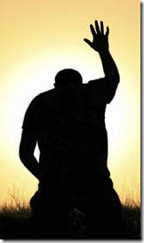
Prayer is a major piece to accomplishing that.
And so we pray (proseuche) in an intimate, face-to-face relationship with God, giving our lives to God...
...we place our needs (deeis) before Him, knowing that we can’t do it on our own...
...and we ask (aiteo) daily for our wants to be supplied...

Slide 14
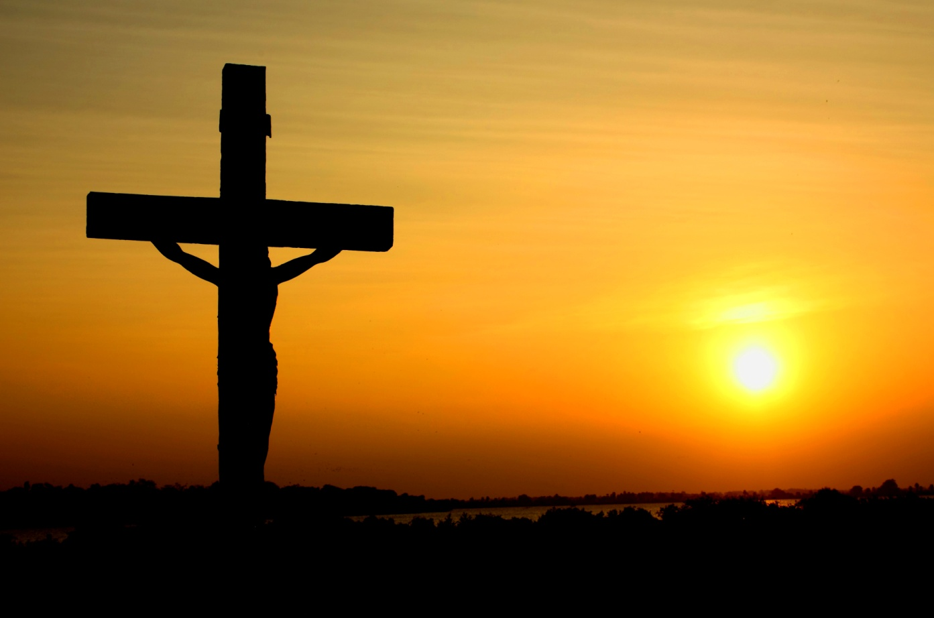
...wanting what God wants...
...needing what God needs for us...
Not my will, God,
YOURS
Notes:
No human in their right mind wants to suffer...be stripped, beaten, humiliated, and die an excruciatingly painful death...and yet Jesus, in his agonized prayers in Gethsemane, said, “Father, I don’t want to die, I don’t want to go through this, but, not my will...Yours.”

Slide 15

God wants everyone, and all of creation...
...to be in right relationship with Him...
...and with each other.
Notes:
Why? Why do we align our wills with God’s will like Jesus did? Why do we want what God wants like Jesus did? The transforming power of prayer helps us to further God’s plan for salvation...to reconcile all things to himself. In prayer we are in relationship with God – we open ourselves up to experience God’s love, we allow God to love us, we express our love for God and his creation, and we grow in love as we bring others with us (in the case of intercessory prayer) into God’s presence. Prayer is a large factor in our ongoing process of sanctification – the process of being made holy – becoming more and more like Christ.

Slide 16
Does
Prayer
Work?
Notes:
Now for the million dollar question.
First of all, it’s not us...

Slide 17


It is God who works!
Our job is to fill the jars with water.
in his time, and in his way,
We must then trust God to do the rest,
and for the
fulfilment of his will.
Notes:
Stephen Cottrell, Praying Through Life, p.28

Slide 18
God hears every prayer.
Ask, and it will be given to you; search, and you will find; knock and the door will be opened to you. (Matt.7.7)
What Father among you would give his son a stone when he asked for bread? Matt.7.9
Notes:
Let’s look at what the Scripture says (and there’s more than what I’m going to show you here).
God hears every prayer – Psalm 139:1-4
A lot of teaching in the gospel centers around asking for things – this is not the heart of prayer...relationship is the heart of prayer but, the relationship is parent to child, asking is a natural part of that.
God cares for us and wants what is best for us...sometimes we don’t...we think we’re asking for bread when we’re asking for a stone. “Be careful what you wish for.” Every parent knows you cannot give to your child everything he or she asks for.

Slide 19

“Intercession is not magic. When we pray we are not asking God to cast a spell. But neither is the whole of life pre-programmed. Things can change for the better, or for the worse. God has made us free. Free to accept his will, free to reject it...Intercession is not a technique for changing God’s mind...we place ourselves in a relationship of co-operation with God. When we pray we are in communion with God, we seek his will and the channels of communication are open. We are available to God and he will work through us.” Stephen Cottrell, Praying Through Life, p.29
Be careful when you ask God to move a mountain...He will hand you a shovel. Anonymous
We can never will what God does not.
Notes:
We are co-workers with God. I pray every night for long life and good health for my parents. One day, my parents will die. One day, one of my parents may die even as I am praying those words. Does that mean that God didn’t listen to me/ didn’t answer my prayer? Every single one of us knows that parents will die at some point. We can not stop the inevitable with prayer...that human beings are mortal is God’s will. We were created mortal. My mum has diabetes. Her lifespan will likely be shorter than the average. She is likely to develop one of many health issues as she ages – vision loss, stroke, heart attack, gangrene...diabetes can lead to a lot of bad things. It could be that, as my mum lies in her hospital bed, she transforms the life of the person in the other bed next to her by sharing the good news, by providing pastoral care. My mum is an ordained priest and is very good at pastoral care. Should I ask God to cure my mum’s diabetes? Well, I could. Would he? Quite possibly. We must remember that we are human...we get sick...we get hurt...That doesn’t happen because God wants it...We have free will. Do miraculous healings happen because of prayer? Absolutely they do. But let’s just picture for a moment, what our world would be like if, every time someone prayed to God, he or she got whatever he asked for...Every healing, every cure, every desire...Our world would be complete and utter chaos. Every daredevil would be jumping the Grand Canyon because God would save him...We are not ready for God to be answering every prayer...In general, we have not progressed enough toward being Christ-like to have God answer every prayer. It would be chaos. In general, our wills have not yet been aligned with God’s will and we will likely keep asking for stones when we think we are asking for bread. Research shows that the majority of people pray only to ask for things, not to praise, not to thank, not to glorify God, not to express love of God...In general, humans are continuously trying to bend God to their will...prayer needs to be more listening than speaking. This is important in every type of prayer but I’ve been noticing a disturbing trend in our intercessory prayer...it’s a list of demands, a list of our wants, with not enough listening...

Slide 20
Remember – prayer is relationship (God/others)...
Father Benson taught that “in praying for others we learn really and truly to love them. As we approach God on their behalf we carry the thought of them into the very being of eternal Love, and as we go into the being of him who is eternal Love, so we learn to love whatever we take with us there.”
Notes:
This is Father Benson talking about intercessory prayer. You can see why this would be transformative for us. Christ welcomed outcasts and sinners. God loves everyone – even those we find unlovable. So, if we pray for those people we don’t like – bring them into God’s presence with us and learn to love them – we are transforming ourselves in love, becoming more like Christ.

Slide 21
It is a wonderful thing that God makes us his fellow-workers and uses our love, acting in intercession, to further the reconciliation of all things in Christ. We offer thanks with joy whenever prayer results in the transformation for which we had hoped. However, we must often suffer the pain of seeing no visible result to our prayer. But we should let no frustration wear down the trust that sustains our waiting on God. Every offering of love will bear fruit. “I will do whatever you ask in my name, so that the Father may be glorified in the Son.” John 14:13
Notes:
This is another quote from the SSJE Rule of Life...we are co-workers with God, furthering his ultimate goal – the plan for salvation; God does things we don’t always understand or a lot of times, that we don’t know about but...(read last two sentences).
William H. Petersen p.27...John Dominac Crossan “You have been waiting for God [Jesus] said, while God has been waiting for you. No wonder nothing is happening. You want God’s intervention , he said, while God wants your collaboration. God’s kingdom is here, but only insofaras you accept it, enter it, live it, and thereby establish it. That is the only possible interpretation that does not render Jesus’ claim of the kingdom a bad and cruel joke. He is announcing not a realized, but a realizable eschaton, or better yet, a collaborative eschaton. The Great Divine Cleanup will not happen without God but neither will it happen without us. It is about a divine-and-human collaboration and not about a divine-only intervention.

Slide 22
“A ceaseless interchange of mutual love unites the Father, Son, and Holy Spirit. Our prayer is not merely communication with God, it is coming to know God by participation in this divine life...”
“Prayer is the most natural thing in the world. It can also be the hardest. Because it is relationship it is about letting go and allowing someone else to be at the centre of your life. In so many ways the human spirit will recoil from this kind of loving. We like to be at the centre ourselves.”
Notes:
Top quote is a full page hand-out. (The Mystery of Prayer SSJE)
2nd quote...doesn’t mean that we’re selfish – although some people are – it is really talking about control. We don’t like to relinquish control – that makes us feel vulnerable and that is contrary to what society tries to instill. Independence is a quality we strive for. (Stephen Cottrell, p.13).

Slide 23
Not my will....YOURS.
We try...we’re a lot like Peter...
“You are the Christ, the Son of the living God” (Matthew 16:16)
“Far be it from you, Lord! This shall never happen to you” (Matthew 16:22).
Whatever it takes, Lord, align my desires with yours, so that my dreams align with your purposes. Let your will be done through me.
Notes:
We find this frightening. At the same time that we’re saying these words, we’re thinking, “But not really – don’t cause me suffering...don’t make me do what I don’t want to do”. Even if we’re not saying those words exactly, there’s still reluctance to really let go of our will and let God use us exactly how he wants to use us...a lot of us don’t really want to be taken out of our comfort zone.

Slide 24
Top Ten Reasons Why Beings Designed to Commune with God Don’t
9. C’mon. God can take care of things without me. Perhaps, maybe, if no one else has a word with him, I’ll think about it. Anyway, things are fine. Can you bring me a beer?
8. Does it involve four scoops of espresso mocha chip with extra walnuts, fudge sauce, and whipped cream? Psalm 34 says “taste and see that the Lord is good.” But what if God isn’t enough to satisfy me?
7. Absolutely! We should have a prayer meeting. Invite everyone. Especially Zoe. She’s such a blast. Have you gone to Zumba with her? Hey, we should throw a dance party. I’ll sign out the rec room.
6. Look. What does God want from me? If he would just tell me straight, I’d do it. James says “you have not because you ask not,” but can you really trust God for a direct correlation? Really? You go first.
Notes:
Dawn Duncan Harrell

Slide 25
5. I’m not sure I have enough information yet to do this properly. But I own every book on prayer I could find and I’ve mapped out my course of study. Have you read Ten Ways to Pray? What did you think?
4. I am not praying the way they did it in my church growing up. Gag! What a heap of dead, formulaic mumbling. I am not jabbering like everyone else does. It’s not me.
3. You need to make prayer more fun if you want everyone to do it. And put an ad on the web. Nobody reads print anymore. It’s inefficient. Anyway, prayer’s a tough sell. It’s not really something you can succeed at.
2. Why doesn’t anyone pray for me? My husband should try it. I’m going to give him a copy of the book. It could help him at work. And my kids. Maybe I can help their dad teach them how to pray.
1. This is all a little melodramatic. What we need is a unified system that everyone can follow. Jesus gives us the perfect prayer—Matthew 6:9–13, Luke 11:2–4. Let’s just do that.

Slide 26
And the very first, ground zero reason why human beings, who were designed specifically for communion with God (Rev 4:11; 21:3), don’t:
0. God called to the human, “Where are you?” And Adam said, “I heard your sound in the garden, and I was afraid, because I was naked; and I hid myself.”—Genesis 3:9–10

Slide 27
Prayer in the Liturgy
“First, liturgical prayer helps us articulate the yearnings of the heart that cry for expression.”
“Second, liturgical prayer helps us unite with the ‘communion of saints.’
“Third, liturgical prayer helps us stand against the temptation to be spectacular or entertaining.”
“Fourth, liturgical prayer helps us resist the temptation of private religion.
“Fifth, liturgical prayer helps us to avoid the familiarity that breeds contempt.”
Notes:
From “Prayer” by Richard Foster, p. 107-
First...sometimes we don’t know what to say, how to say what we’re feeling, and sometimes we don’t feel like praying and a beautiful prayer in the liturgy can get us in the mood for our prayers, can put us into a prayerful attitude.
Second...we are part of something much larger than ourselves – part of a worldwide communion, we pray together as a family; also, in terms of history, we’re adding our voices to a long line of voices going back hundreds upon hundreds of years.
Third...we focus on the words instead of the person saying them.
Fourth...it is very human to allow our own concerns to become the bulk of the prayer. It’s not wrong to pray for our own needs but that must never be the end of our prayer work. The liturgy brings us back to the life of the whole community. In addition, liturgical prayer keeps us within the bounds of sound doctrine.
Fifth...by this Foster means famililiarity with God...we are often confronted with songs and hymns and thinking that encourages to view Jesus as a friend. We must remember that God is also infinite, all powerful, all knowing, eternal, our creator, our judge...God deserves our love but also our respect...In the bible, people who encounter God often fall to the ground as though dead. The stateliness and formality of the liturgy remind us that we are in the presence of real Royalty.

Slide 28
Concerns
The sameness...you’re not really thinking about what you’re saying; you’re just doing it by rote.
O God, make speed to save us.
O Lord, make haste to help us.
“I do not have to concern myself with how to express my need. Rather I am free to enter into the depth of my need as well as the reality that God’s resources are deeper still.” p. 109
We must be careful: “The beauty and precision of the worship service can supersede heartfelt yearning for God.” p.109
Notes:
Well, yes, we are...but that’s an asset. C.S. Lewis agrees wholeheartedly with Richard Foster on this point so let me share with you what Lewis says: As long as you notice, and have to count, the steps, you are not yet dancing but only learning to dance. A good shoe is a shoe you don’t notice. Good reading becomes possible when you need not consciously think about eyes, or light, or print, or spelling. The perfect church service would be one we were almost unaware of; our attention would have been on God. P.408 of “The Essential C.S Lewis” (From Letters to Malcolm: Chiefly on Prayer)

Slide 29
There is no such thing as private prayer!
When we pray we are in solidarity with Christian people everywhere.
When we pray the Holy Spirit prays with us.
The prayer of the Church on earth is joined with the prayer of the Church in heaven.
Notes:
One more reason why praying in our liturgy is so important, it’s a key feature of all prayer...
This is something I first read in a book by Stephen Cottrell called, “Praying Through Life”. P.19-21. Even when we are physically alone, we are part of something larger than ourselves.
Solidarity...at any given time, when you pray, millions of Christian people around the world are also praying. All of these prayers – and all of the prayers of people gone before us – are a voice praying to God.
When you think of prayer as a private affair, people worry that it depends on their own abilities, that they won’t pray properly, but actually, it is the Spirit within us who prays with us and will guide us when we don’t know what to say.
Joined with heaven...Therefore with angels, and archangels, and with all the company of heaven...Maybe it doesn’t feel like that because you hadn’t thought of that. Now you know.
Cottrell goes on to say, “The Christian life can be very personal, but it can never be private. But this is precisely how many people see it. They want their own private relationship with God; they readily talk about my faith and my prayers. We must vigorously challenge this view, otherwise the whole Christian faith is reduced to a private option with no claim upon the whole of life. In fact the very word ‘private’ comes from the Latin verb privo which means to steal! The Christian life is corporate and public, and whenever we imagine that being a Christian is just about me and God, we rob the Christian faith of its true catholicity.” p.21
And so, we pray together, we worship together, we work together...and even when we pray alone, we are not really alone. This brings us back to how crucial prayer really is...the transformative power of prayer through God’s love...

Slide 30
God wants everyone, and all of creation...
...to be in right relationship with Him...
...and with each other.
Notes:
Before slide: Just to go back to that question “does prayer work?” – we really must stop lookjng at prayer from that angle – prayer works when my wishes come true; when I get what I asked for...I’m not saying stop asking – keep asking, keep petitioning – that’s part of prayer and God tells us to do that – but do that with the proper lens in place...prayer is about being in relationship with God, open to God’s love, being transformed within that relationship and listening to God in order to align our will with God’s will. And so, - Prayer – What’s the Use? Show slide...

